Slide 1

Responsive Web Design Principles

Slide 2
What is Responsive Web Design?
Responsive web design is all about creating websites & web pages that render well on all screen sizes and resolutions while ensuring good usability. It is the way to design for a multi-device web.
Responsive web design isn't a separate technology — it is an approach. It is a term used to describe a set of best practices used to create a layout that can respond to any device being used to view the content.
A Responsive Web Design enlarges, shrinks, resizes, or hides content present as per the screen size of the device.

Slide 3
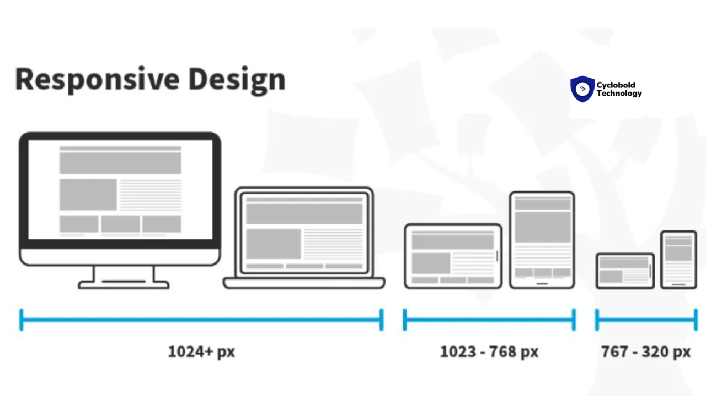

Slide 4
When & Who introduced RWD?
Responsive web design (RWD) was introduced in 2010 by Ethan Marcotte. He coined the term in an article published on A List Apart, where he outlined the foundational principles of responsive design. Later the year, he expanded all these ideas in his book titled "Responsive Web Design".
The concept was developed in response to the increasing variety of screen sizes and devices used to access the web. Marcotte's approach combined fluid grids, flexible images, & media queries to create designs that could adapt seamlessly across different screen sizes, paving the way for modern web design practices.

Slide 5
Importance of responsive designs
User Experience
SEO (Search Engine Optimization) Performance
Cost Effectiveness
Flexibility
Faster Performance

Slide 6
Some Principles of Responsive Web Design include:
Fluid Grids
Responsive images
Media queries
Mobile-first approach
Prioritize performance optimization
Use Scalable Vector Graphics (SVGs)
Prioritize accessibility

Slide 7








Some common frameworks used for responsive design

Slide 8
Thank You !!

